Slide 1
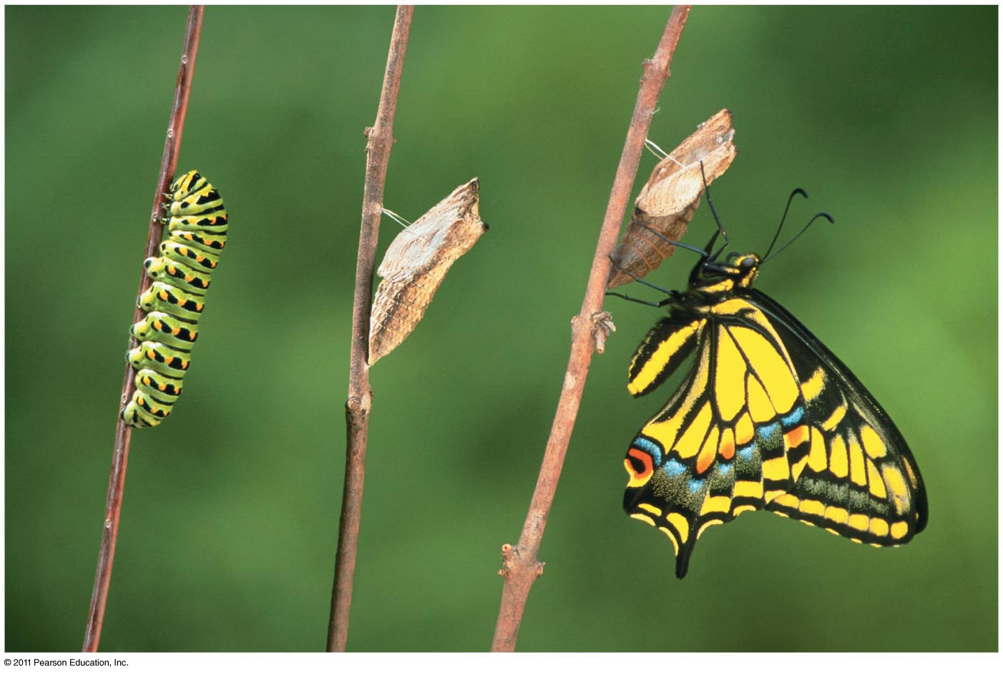
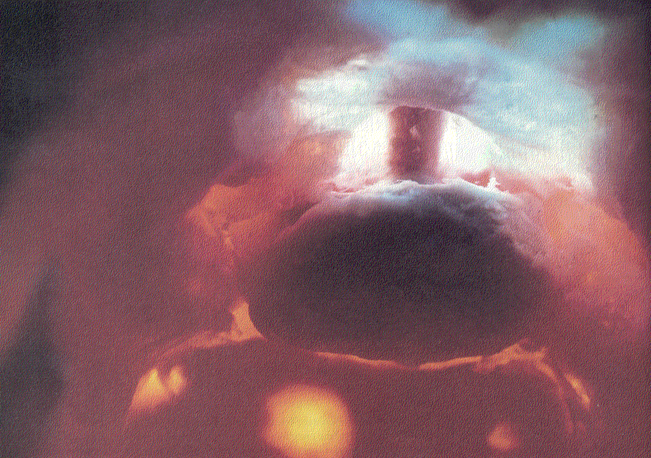
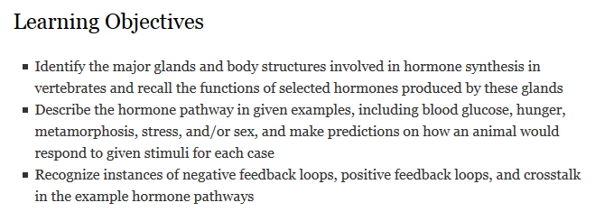
Animal Hormones
Notes:
The pituitary gland, hanging by a short stalk from the hypothalamus, regulates hormone production in many of the body’s endocrine glands
Animals use at least six major types of chemical signals. Hormones are chemical signals that are present in tiny concentrations and travel throughout the body to affect target cells.
The information in hormonal signals helps animals respond to environmental change, develop as embryos, undergo sexual maturation, and achieve homeostasis.
The production of a hormone is tightly regulated by input from the nervous system and by other hormones.
Hormones may reach all parts of the body, but only certain types of cells (target cells) have the ability to respond

Slide 2
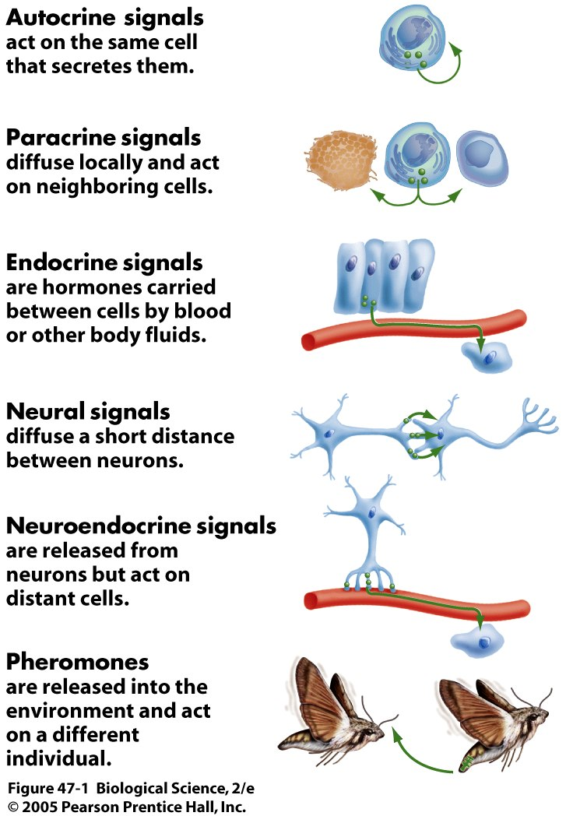
Chemical signaling in animals
Common features of hormones:
Secreted
Act on distant cells
Small amounts; large effects
Characteristic responses
Feedback loops
Common function of hormones:
Regulate homeostasis, development, reproduction, stress response
Changes in transcription
Changes in protein activity
Coordinate activities of multiple cells
Named for shared FUNCTION, not shared STRUCTURE
Notes:
2
Endocrine signals are produced by cells that may be organized into discrete organs called glands or may be interspersed among the cells of other organs.
Neuroendocrine signals are released from neurons but act on distant cells instead of acting at the adjacent synapse.
features of hormones:
Secreted from cells that synthesize them
Transmitted through blood or other fluids
Act on distant cells
Trigger characteristic responses
Secreted in small amounts/low concentrations but have large effects
Often triggered by signals from neurons or other hormones
Often have feedback loops (negative for most hormones involved in homeostasis)
Function of hormones:
Regulate homeostasis, development, reproduction, stress response
Changes in transcription
Changes in protein activity
Coordinate activities of multiple cells
Endocrine signals are produced by cells that may be organized into discrete organs called glands or may be interspersed among the cells of other organs.
Neuroendocrine signals are released from neurons but act on distant cells instead of acting at the adjacent synapse.

Slide 3
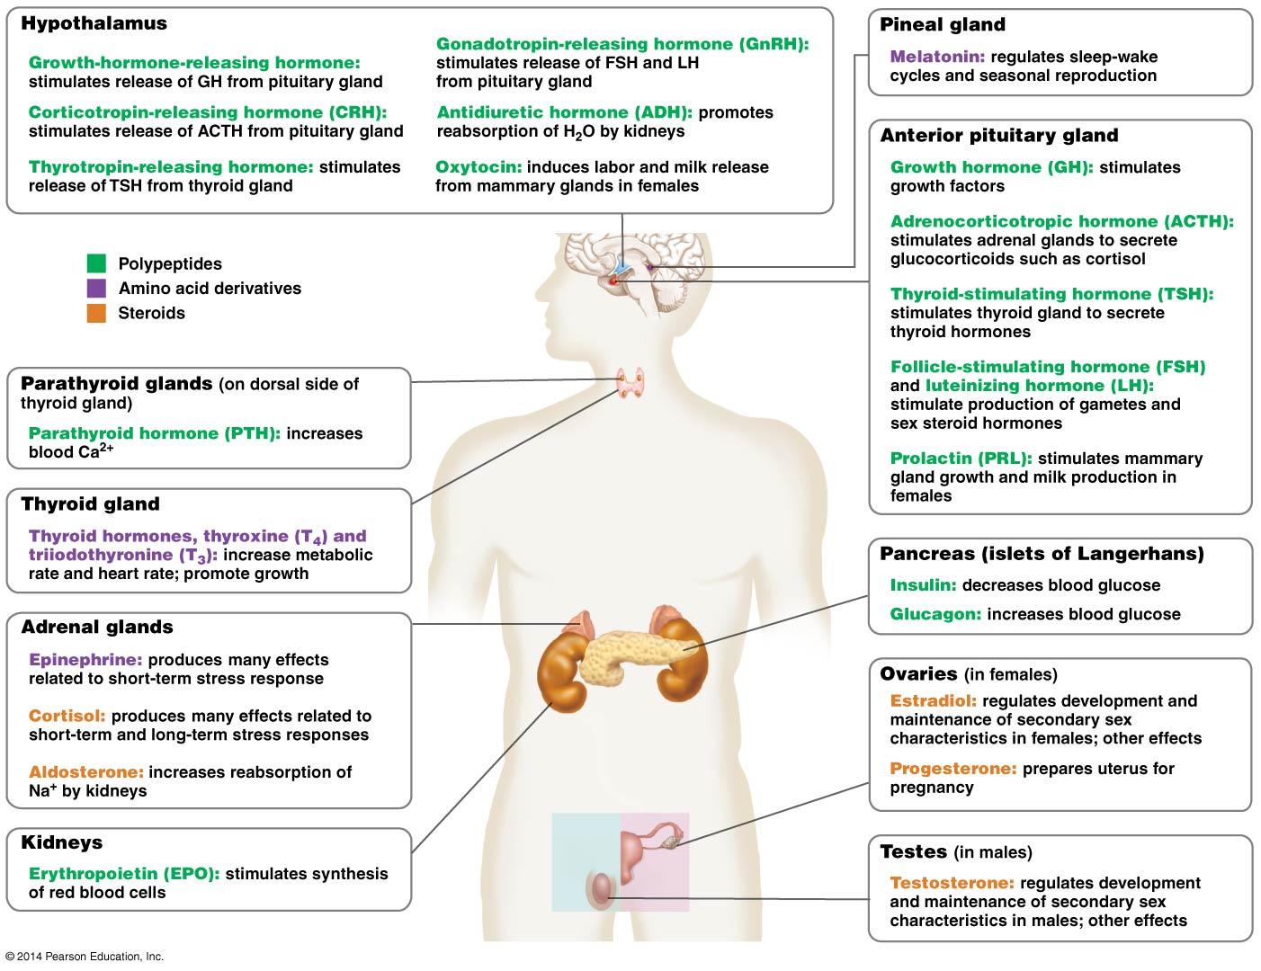
Notes:
3
Glands and organs of the human endocrine system
The hypothalamus, which is a region deep within the brain
The pituitary gland, which sits just below the hypothalamus and has distinct anterior and posterior regions
The thyroid gland, which is situated in the neck
The four parathyroid glands, which are embedded in the thyroid gland
The two kidneys, which lie in the posterior part of the abdominal cavity
The two adrenal glands, which sit atop the kidneys and have an outer cortex and a central medulla
The endocrine component of the pancreas, which is located in the anterior part of the abdominal cavity
The paired ovaries (in females) or testes (in males), which are in or suspended below the pelvic cavity, respectively

Slide 4
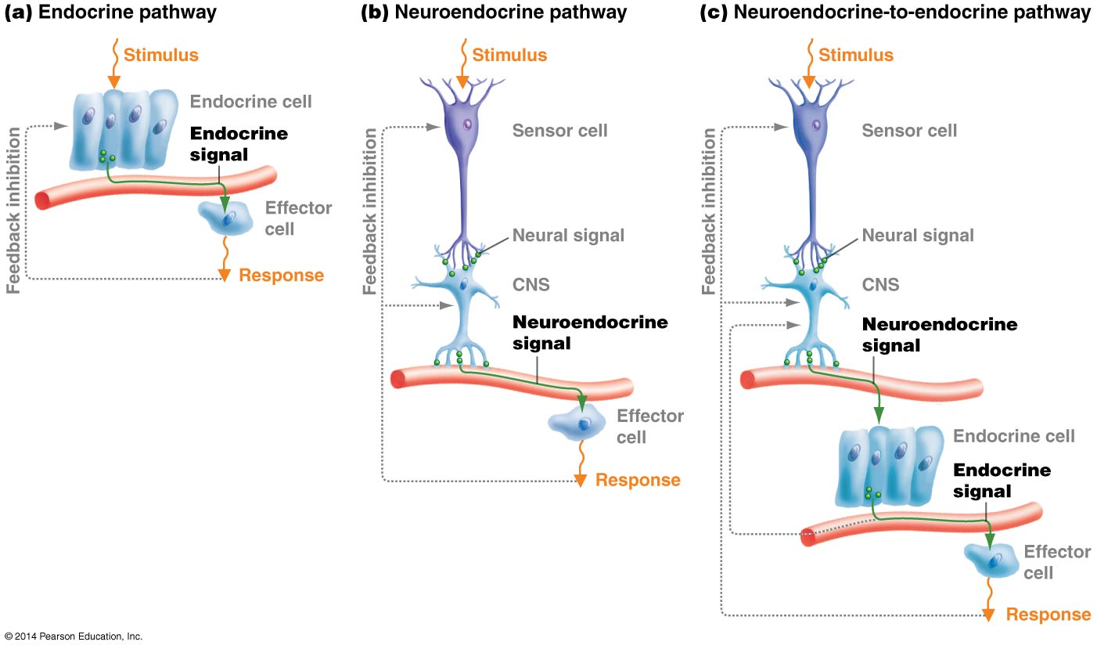
Endocrine pathway: stimulus acts directly on the hormone-producing cell, which releases hormones which then travel through the blood stream to act on the effector cell
Neuroendocrine pathway: stimulus acts on a sensory cell which transmits the information to a neuron. A neuroendocrine cell releases hormones which then travel through the blood stream to act on the effector cell
Neuroendocrine-to-endocrine pathway: stimulus acts on a sensory cell which transmits the information to a neuron. A neuroendocrine cell releases hormones which then travel through the blood stream to act on another hormone-producing cell, which releases hormones which then travel through the blood stream to act on the effector cell
Notes:
4
Endocrine pathway: Some hormones feedback loops do not involve the nervous system; the stimulus acts directly on the hormone-producing cell, which releases hormones which then travel through the blood stream to act on the effector cell
Neuroendocrine pathway: The stimulus acts on a sensory cell which transmits the information to a neuron in the CNS. A neuroendocrine cell of the CNS releases hormones which then travel through the blood stream to act on the effector cell
Neuroendocrine-to-endocrine pathway: The stimulus acts on a sensory cell which transmits the information to a neuron in the CNS. A neuroendocrine cell of the CNS releases hormones which then travel through the blood stream to act on another hormone-producing cell, which releases hormones which then travel through the blood stream to act on the effector cell

Slide 5
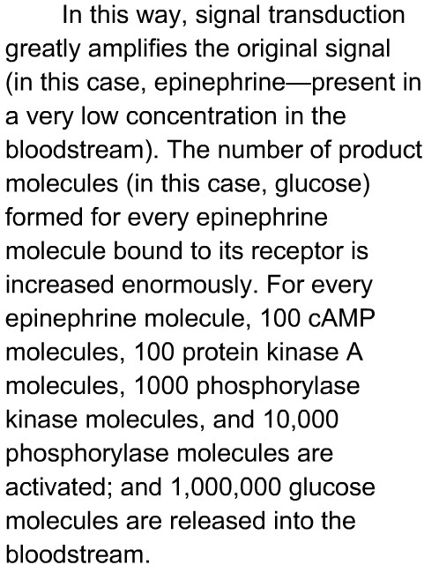
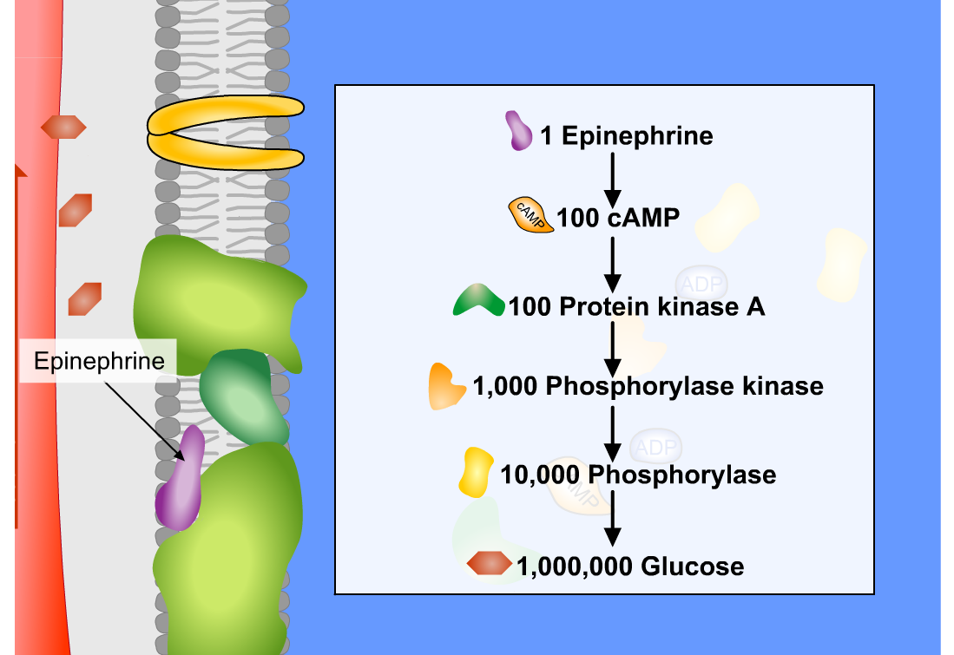
Amplification of the signal
Notes:
See text to the right of the image

Slide 6
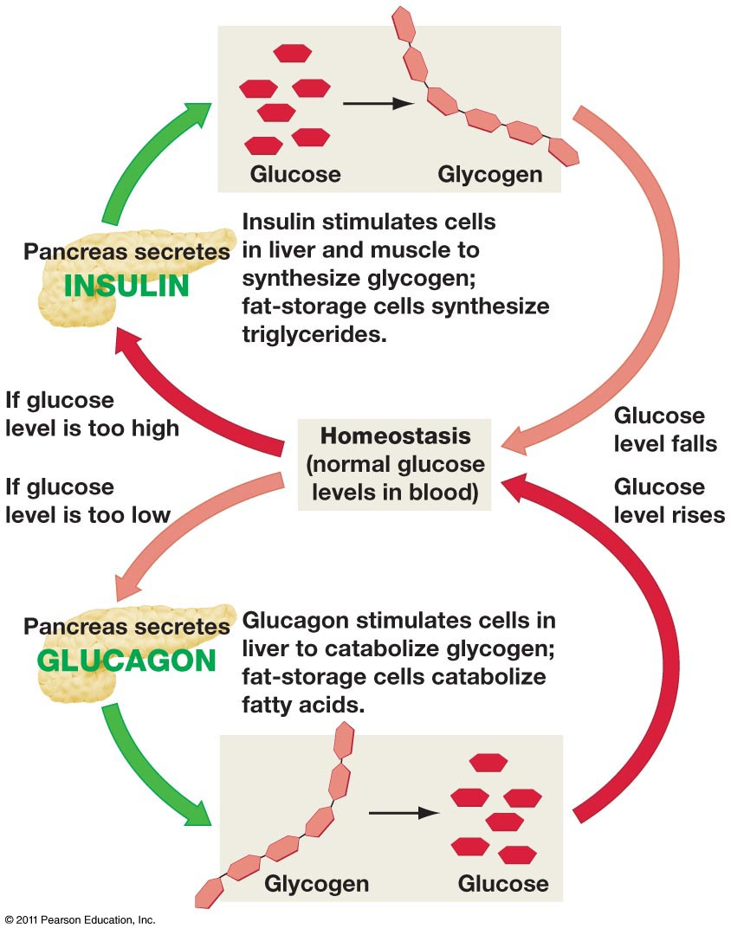
Target blood glucose concentration: 90 mg/100 mL
This equates to ~1 tsp of glucose per 6 qts of blood
When blood glucose is too high:
Insulin is secreted by beta cells in the islets of Langerhans in the pancreas
Insulin activates receptors in the liver and muscle
The liver and muscle take up glucose from the blood stream and store it as glycogen
When blood glucose is too low:
Glucagon is secreted by alpha cells in the islets of Langerhans in the pancreas
Glucagon activates receptors in the liver
The liver breaks down stored glycogen into glucose and releases glucose into the blood stream to increase blood glucose levels
Freeman 4e 43.16
Notes:
Target blood glucose concentration: 90 mg/100 mL
This equates to ~1 tsp of glucose per 6 qts of blood
When blood glucose is too high:
Insulin is secreted by beta cells in the islets of Langerhans in the pancreas
Insulin activates receptors in the liver and muscle
The liver and muscle take up glucose from the blood stream and store it as glycogen
When blood glucose is too low:
Glucagon is secreted by alpha cells in the islets of Langerhans in the pancreas
Glucagon activates receptors in the liver
The liver breaks down stored glycogen into glucose and releases glucose into the blood stream to increase blood glucose levels

Slide 7
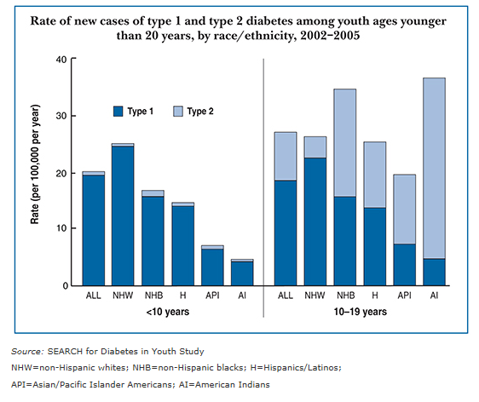
http://www.who.int/diabetes/facts/en/diabcare0504.pdf
What are potential causes for the rise of diabetes?
Freeman 4e 43.17
Notes:
The prevalence of diabetes for all age-groups worldwide was estimated to be
2.8% in 2000 and 4.4% in 2030. The total number of people with diabetes is projected to rise
from 171 million in 2000 to 366 million in 2030. The prevalence of diabetes is higher in men
than women, but there are more women with diabetes than men. The urban population in
developing countries is projected to double between 2000 and 2030. The most important
demographic change to diabetes prevalence across the world appears to be the increase in the proportion of people 65 years of age.
CONCLUSIONS— These findings indicate that the “diabetes epidemic” will continue even if levels of obesity remain constant. Given the increasing prevalence of obesity, it is likely that these figures provide an underestimate of future diabetes prevalence.
http://www.emedicinehealth.com/diabetes/article_em.htm for additional details on diabetes.

Slide 8
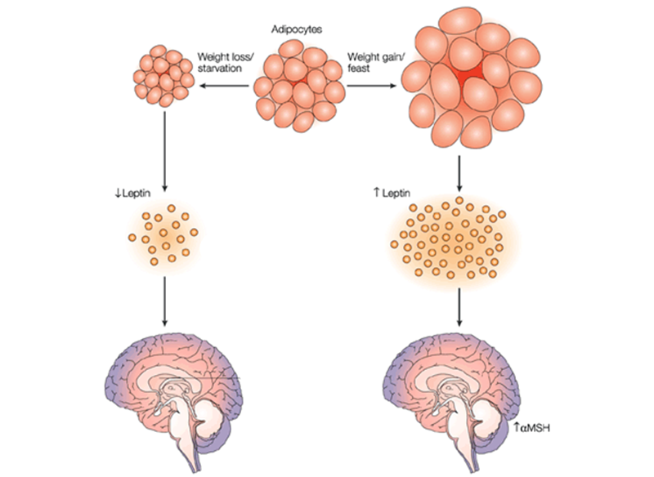
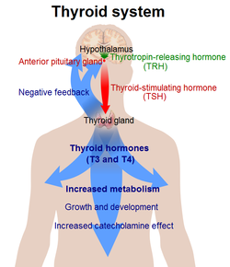
Hunger Management in Mammals
Adipocytes (fat storage cells) secrete leptin. Leptin levels are detected by receptors in the hypothalamus. High levels of leptin suppress appetite, while low levels of leptin stimulate appetite.
Eat more
Eat less
Adapted from Steinman and Zamvil, Nat Rev Immunol 2003
Notes:
Adipocytes (fat storage cells) secrete leptin. Leptin levels are detected by receptors in the hypothalamus. High levels of leptin suppress appetite, while low levels of leptin stimulate appetite. Because leptin is secreted by fat cells, the amount of fat present in the body dictates the amount of leptin, which is interpreted by the hypothalamus which then secretes differing amounts of trh which stimulates the anterior pituitary to secrete tsh, which stimulates the thyroid to secrete differeing amounts of t3 and t4. in this way the body’s metabolic rate is influenced by the amount of fat.

Slide 9
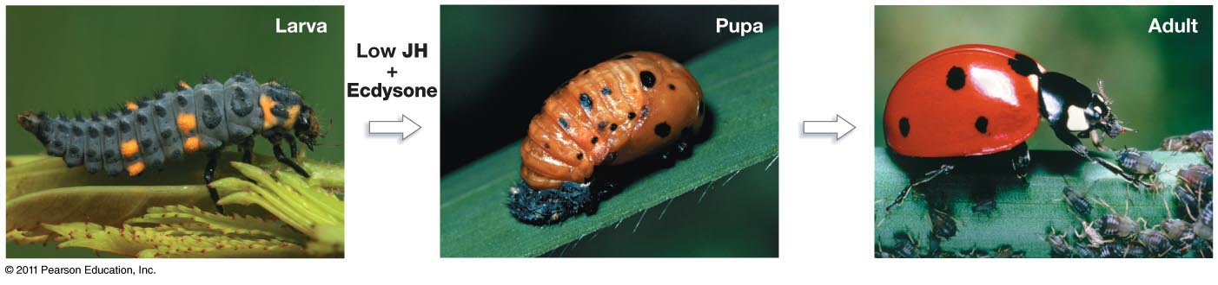
Growth Hormones
Insects
Amphibians
Humans
Freeman 4e 47.1
Notes:
In insects, this is controlled by neuro-endocrine signaling
Depending on the levels of Juvenile Hormone, the growth hormone Ecdysone in insects promotes molting, pupation, or metamorphosis.
In vertebrates, the growth hormone stimulates growth of bones and elevated glucose levels

Slide 10
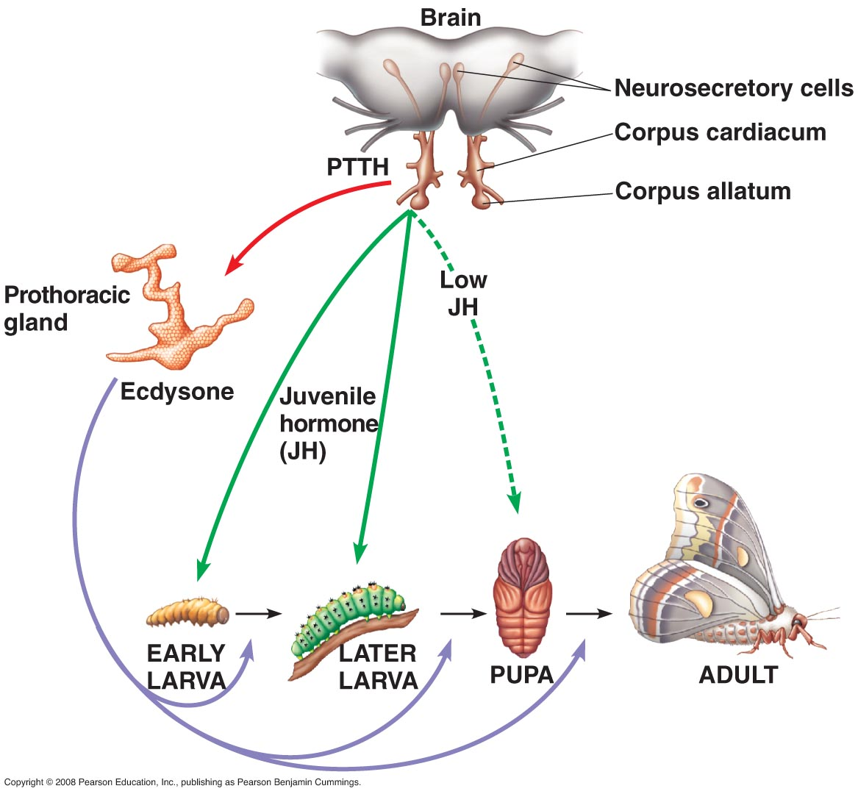
0. Corpus allatum secretes juvenile hormone (JH) during larval stages
1. Prothoracicotropic hormone (PTTH) released due to environmental stimulus
2. PTTH causes surge of ecdysone secreted by PT glands
What happens when juvenile hormone levels are low?
3. Ecdysone promotes either molting or metamorphosis
4. Level of JH (secreted by corpus allatum) determines result of molt
What would happen if you surgically remove the corpus allatum? Or the prothoracic gland?
Campbell 8e 45.13
Notes:
Diff effects of ecdysone dept on level of JH: crosstalk
No corpus allatum: metamorphosis @ first molt
Synthetic JH used as pest control
What would happen if you surgically remove the corpus allatum? Or the prothoracic gland?

Slide 11
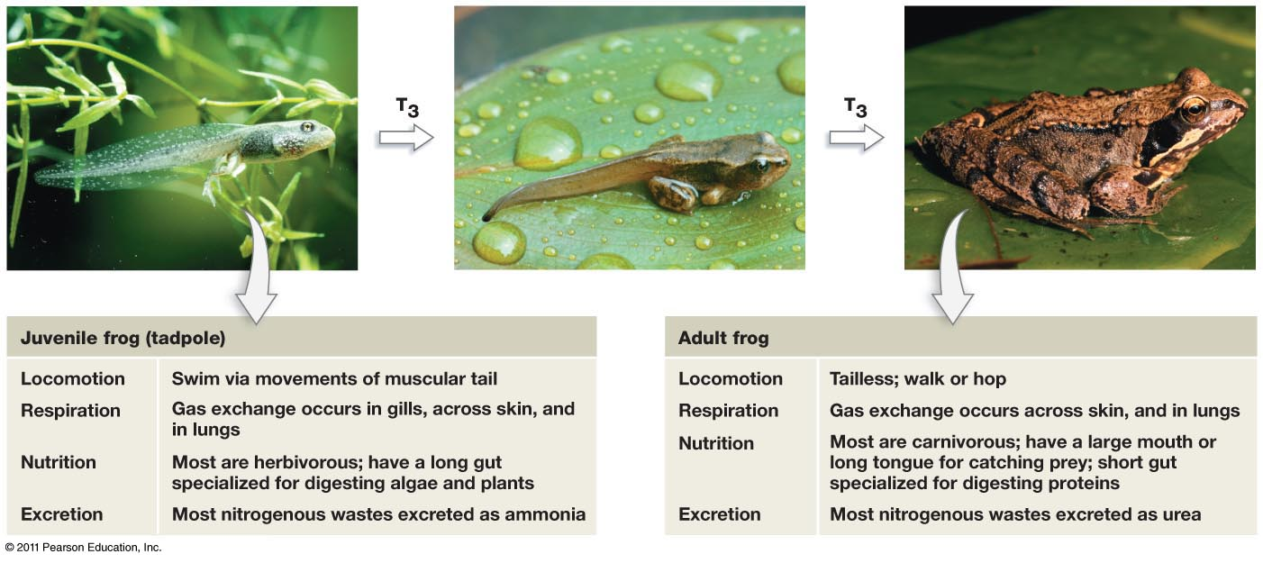
Triiodothyronine surges control amphibian metamorphosis
What would happen if you…
Remove the thyroid?
Stimulate T3 production at the wrong stage?
Notes:
Increased levels signal multiple organs to begin physiological process of metamorphosis
Growth of new structures, cell apoptosis, reorganization of internal systems

Slide 12
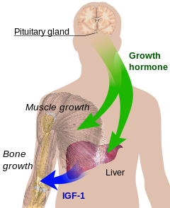
Control of growth in humans
Human growth hormone (HGH)
Produced in anterior pituitary
Levels vary throughout life stages
During adolescence, increases bone growth and IGF production
Also increases calcium absorption, increase protein synthesis and muscle mass, promotes glucose circulation
Thyroxine (T4) and Triiodothyronine (T3)
Produced in thyroid
Levels vary throughout day
Increasing protein synthesis, basal metabolic rate, and energy metabolism
Wikimedia commons
Notes:
Too much GH: The most common disease of GH excess is a pituitary tumor composed of somatotroph cells of the anterior pituitary. These somatotroph adenomas are benign and grow slowly, gradually producing more and more GH. For years, the principal clinical problems are those of GH excess. Eventually, the adenoma may become large enough to cause headaches, impair vision by pressure on the optic nerves, or cause deficiency of other pituitary hormones by displacement.
Prolonged GH excess thickens the bones of the jaw, fingers and toes. Resulting heaviness of the jaw and increased size of digits is referred to as acromegaly. Accompanying problems can include sweating, pressure on nerves (e.g., carpal tunnel syndrome), muscle weakness, excess sex hormone-binding globulin (SHBG), insulin resistance or even a rare form of type 2 diabetes, and reduced sexual function.
GH-secreting tumors are typically recognized in the fifth decade of life. It is extremely rare for such a tumor to occur in childhood, but, when it does, the excessive GH can cause excessive growth, traditionally referred to as pituitary gigantism.
Too little: The effects of growth hormone deficiency vary depending on the age at which they occur. In children, growth failure and short stature are the major manifestations of GH deficiency, with common causes including genetic conditions and congenital malformations. It can also cause delayed sexual maturity. In adults, deficiency is rare,^{[31]} with the most common cause a pituitary adenoma
Thyroid hormones
Increasing protein synthesis, basal metabolic rate, and energy metabolism; catecholamines = epinephrine and norepinephrine & dopamine

Slide 13
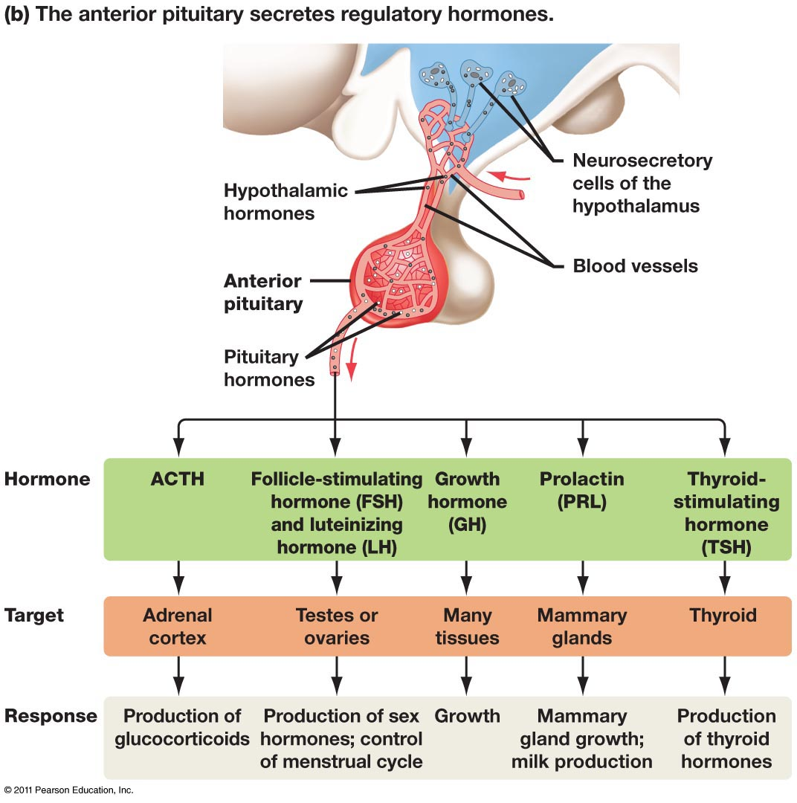
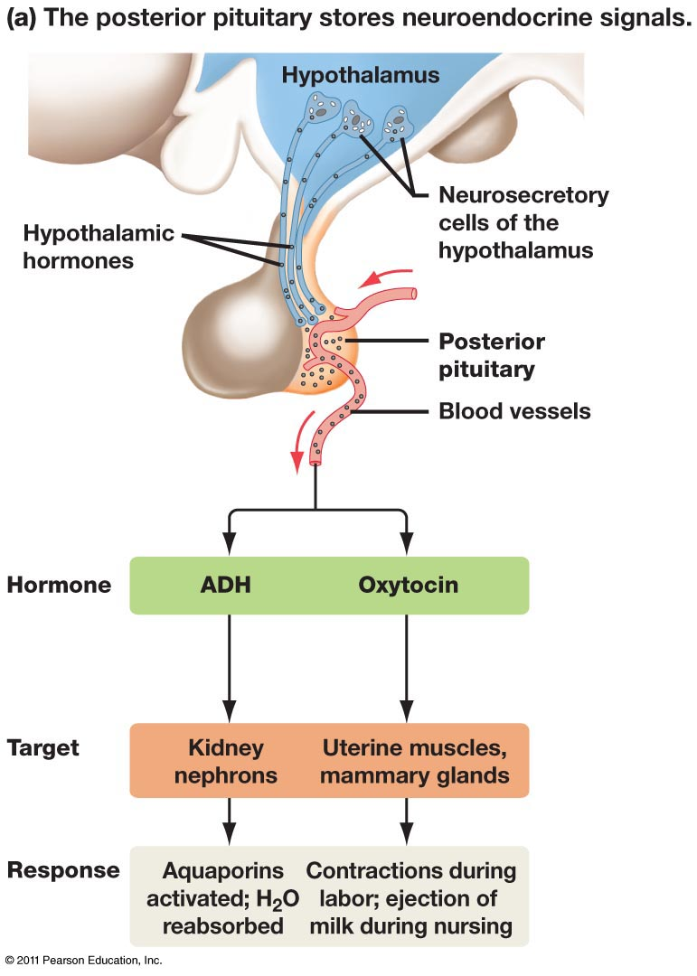
The Hypothalamus-Pituitary axis
Adreno-
corticotropic hormone
Freeman 4e 47.12
Notes:
Anterior pituitary: neuroendocrine-to-endocrine pathway
Posterior pituitary: neuroendocrine pathway

Slide 14
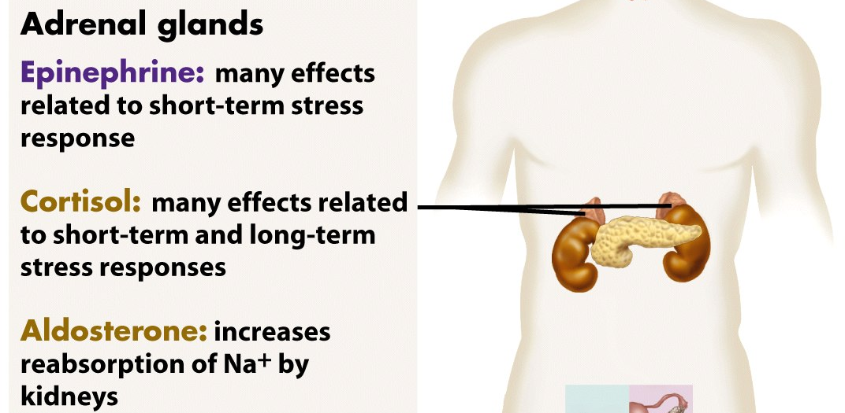
Stress Hormones
Hormones regulate both the short-term and long-term responses to stress.
adrenal medulla (center): epinephrine (adrenaline) and norepinephrine.
adrenal cortex (outer edge): cortisol (a glucocorticoid) and mineralocorticoids.
Glucocorticoid:
Mineralocorticoid:
Notes:
14
The adrenal glands Are adjacent to the kidneys; Are actually made up of two glands: the adrenal medulla and the adrenal cortex
Epinephrine and norepinephrine are members of a family of molecules called catecholamines, which function as neurotransmitters as well as hormones.
Glucocorticoids, such as cortisol Influence glucose metabolism and the immune system
Mineralocorticoids, such as aldosterone Affect salt and water balance
Sex hormones Are produced in small amounts

Slide 15
Short and long-term stress responses involve energy use
Short term:
The responses to epinephrine lead to a state of heightened alertness and increased energy use that prepares the body for rapid, intense action such as fighting or fleeing.
Glycogen breakdown in liver and skeletal muscles
Glucose release by liver
Release of fatty acids from adipose tissue
What are other effects in the body with respect to blood flow and blood pressure in a short-term stress response?
Long term:
The long-term stress response is a compromise in which the fuel requirements of the brain are met at the expense of other tissues and organs.
The primary role of glucocorticoids during prolonged stress in humans is to ensure the continued availability of fuel molecules to support important body functions.
Promote glucose synthesis from muscle proteins
How do glucocorticoids affect the immune system?
The primary role of mineralocorticoids during prolonged stress in humans is to maintain salt and water balance.
Aldosterone promotes kidneys to reabsorb minerals
How would this affect blood pressure and volume?
Notes:
15

Slide 16
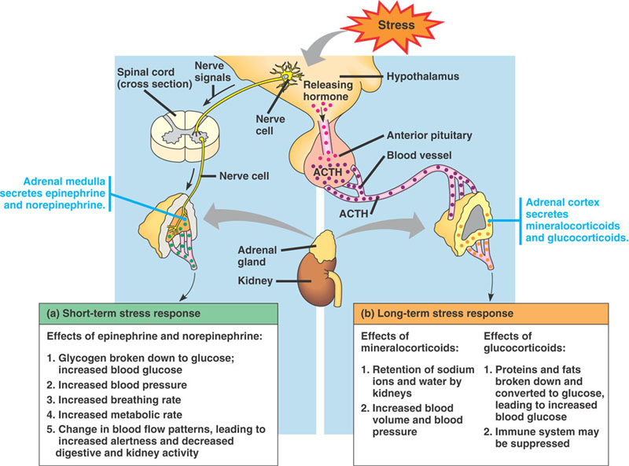
Corticotropin releasing hormone
Adrenocorticotropic hormone
Note different sources of glucose
Fig 45.21 Campbell & Reece
Notes:
Why fight or flight from neuron directly? Must be fast
Note source of sugar in each case

Slide 17
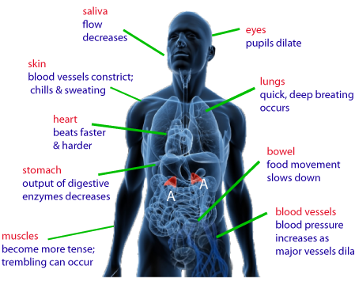
Epinephrine mediates the fight or flight response
Stress response involves ENERGY use; leads to a state of heightened alertness and increased energy use that prepares the body for rapid, intense action such as fighting or fleeing.
How are all these different responses mediated by one hormone?
Notes:
Stress response involves ENERGY use
The responses to epinephrine lead to a state of heightened alertness and increased energy use that prepares the body for rapid, intense action such as fighting or fleeing.
Glycogen breakdown in liver and skeletal muscles
Glucose release by liver
Release of fatty acids from adipose tissue
What other effects to blood flow and blood pressure?

Slide 18
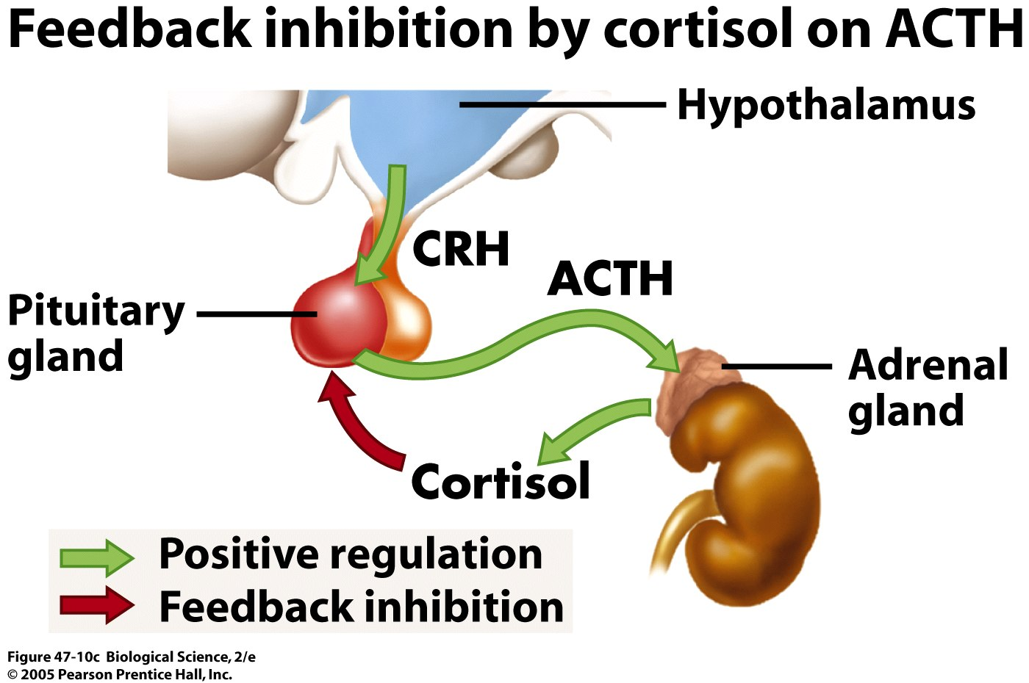
1. Hypothalamus responds to stimuli and produces corticotropin-releasing hormone (CRH)
2. Anterior pituitary releases adrenocorticotropin hormone (ACTH)
3. ACTH stimulates cortex to release cortisol (and others)
4. High levels of cortisol inhibits release of ACTH and CRH
Freeman 4e 47.10
Notes:
18
Adrenocorticotropic hormone (ACTH) is a regulatory hormone that controls release of glucocorticoids from the adrenal cortex Corticotropin-releasing hormone (CRH) is released from the hypothalamus and regulates ACTH secretion into the bloodstream.

Slide 19
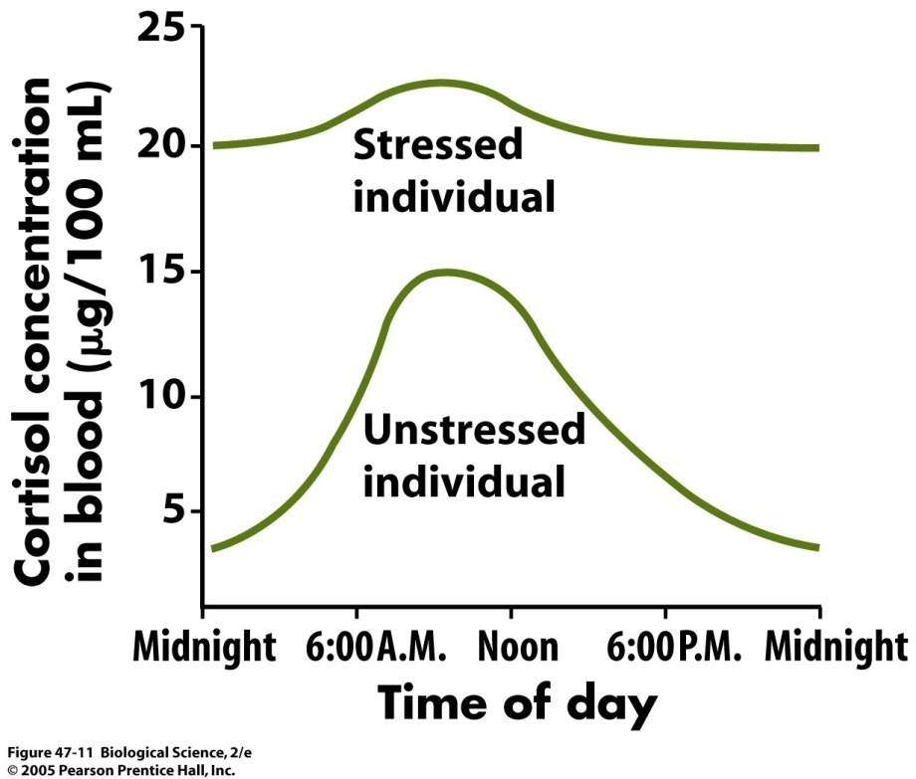
Cortisol normally exhibits a daily cycle…
Except when the body is under long-term stress.
Freeman 4e 47.11
Notes:
The function of cortisol awakening response (CAR) is unknown but it has been suggested to link with a stress-related preparation in regard to the upcoming day by the hippocampus. One hypothesis is: "that the cortisol rise after awakening may accompany an activation of prospective memory representations at awakening enabling individual's orientation about the self in time and space as well as anticipation of demands of the upcoming day... it is tempting to speculate that for the CAR, anticipation of these upcoming demands may be essential in regulating the CAR magnitude for the particular day. The hippocampus is, besides its established role in long-term memory consolidation, involved in the formation of a cohesive construct and representation of the outside world within the central nervous system processing information about space, time and relationships of environmental cues. This puts the hippocampus in a pivotal position for the regulation of the CAR.

Slide 20
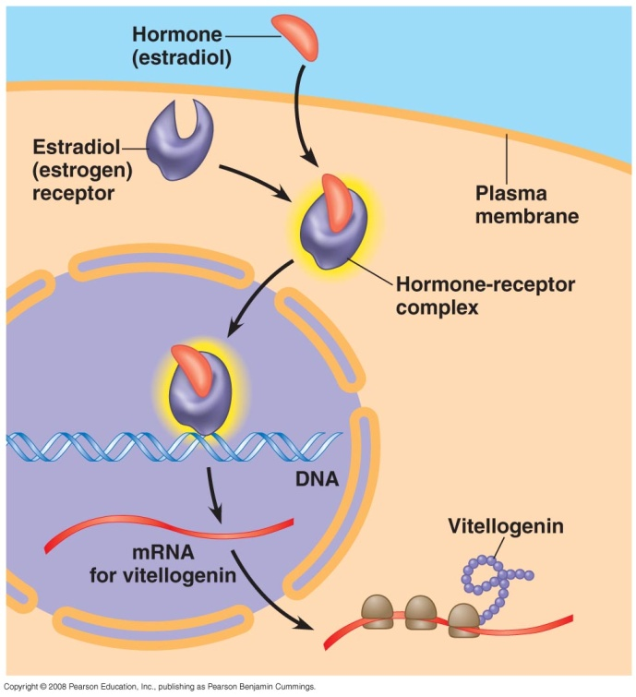
Sex Hormones
Synthesized from cholesterol
Male hormones: androgens
Female hormones: estrogens and progestins
Primary source: gonads (adrenal cortex produces small quantities)
Fig 45.7 Campbell & Reece
Notes:
Sex hormones regulate growth,
development, reproductive cycles,
and sexual behavior
These steroid hormones are synthesized from cholesterol
Male hormones: androgens
Female hormones: estrogens and progestins
Primary source is gonads; adrenal cortex also produces androgens and small qty of estrogens & progestins

Slide 21
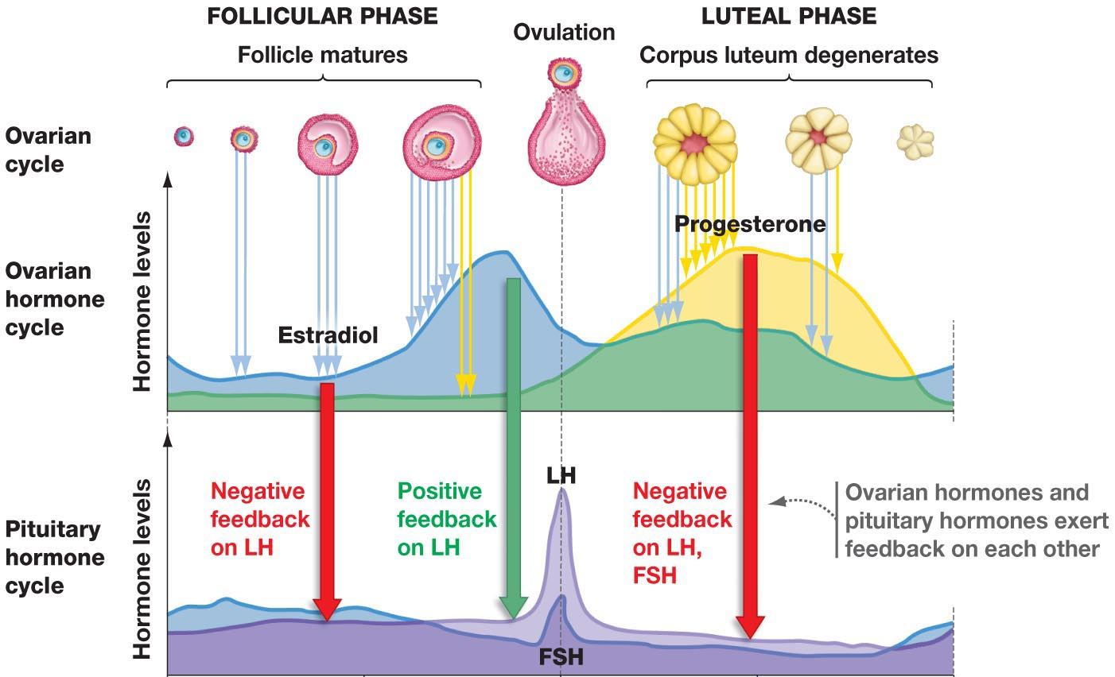
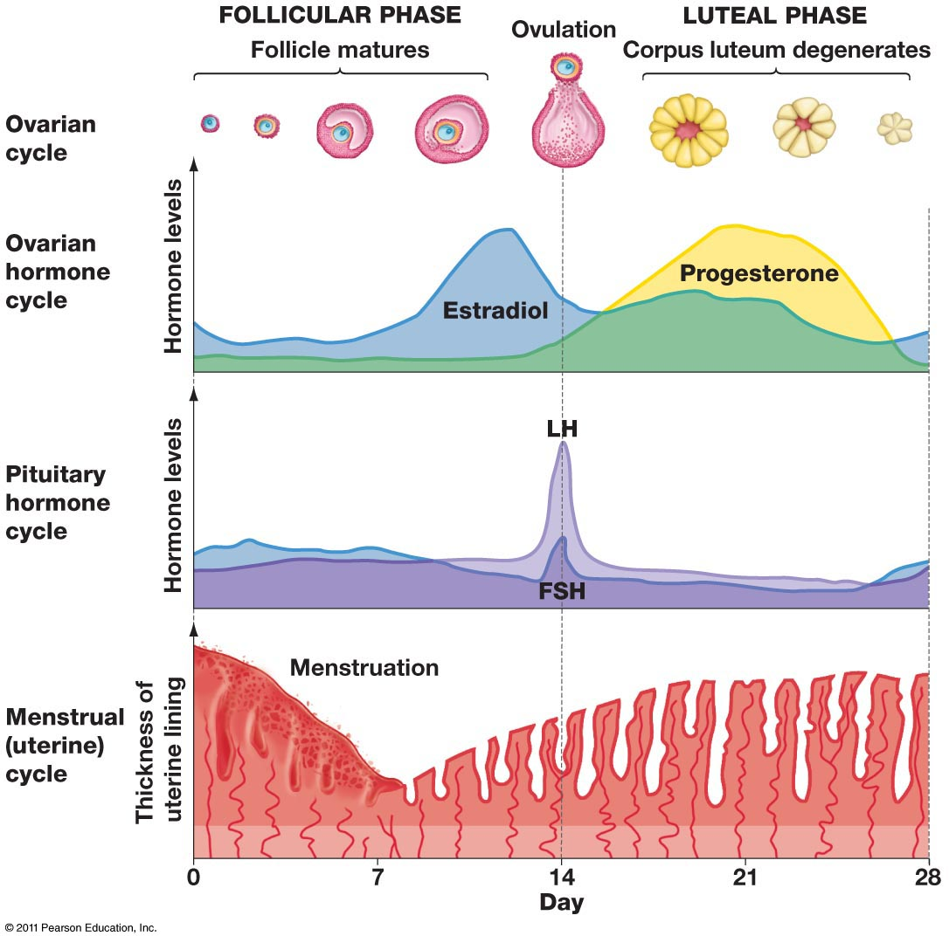
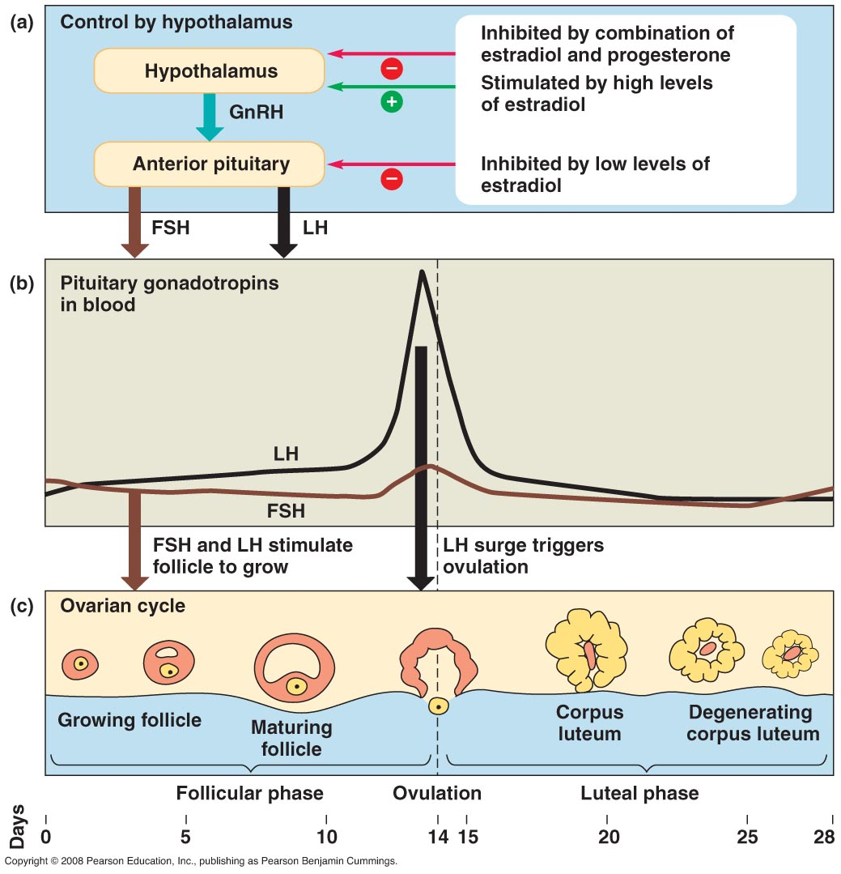
Hormonal control of the menstrual cycle
GnRH secretes low levels of FSH & LR → follicle begins maturing
Maturing follicle secretes high levels of estradiol which → GnRH
GnRH → LH surge → ovulation
Corpus luteum secretes progesterone which inhibits GnRH
Low GnRH results in degenerating corpus luteum, cycle can repeat
Gonadotropin releasing hormone
Notes:
Ovaries produce estradiol and progesterone. The presence of both maintains uterine lining, if a fertilized egg is not present and producing hCG, then the corpus luteum degenerates and ceases production of progesterone. The contributes to onset of menstruation.
Pituitary respond to growing levels of estradiol and produce spike in FSH and LH that results in ovulation.
Point out the connections to previous slide of egg/follicle activity, as well as how the cycle is counted with day 1 = first day of menstruation.

Slide 22
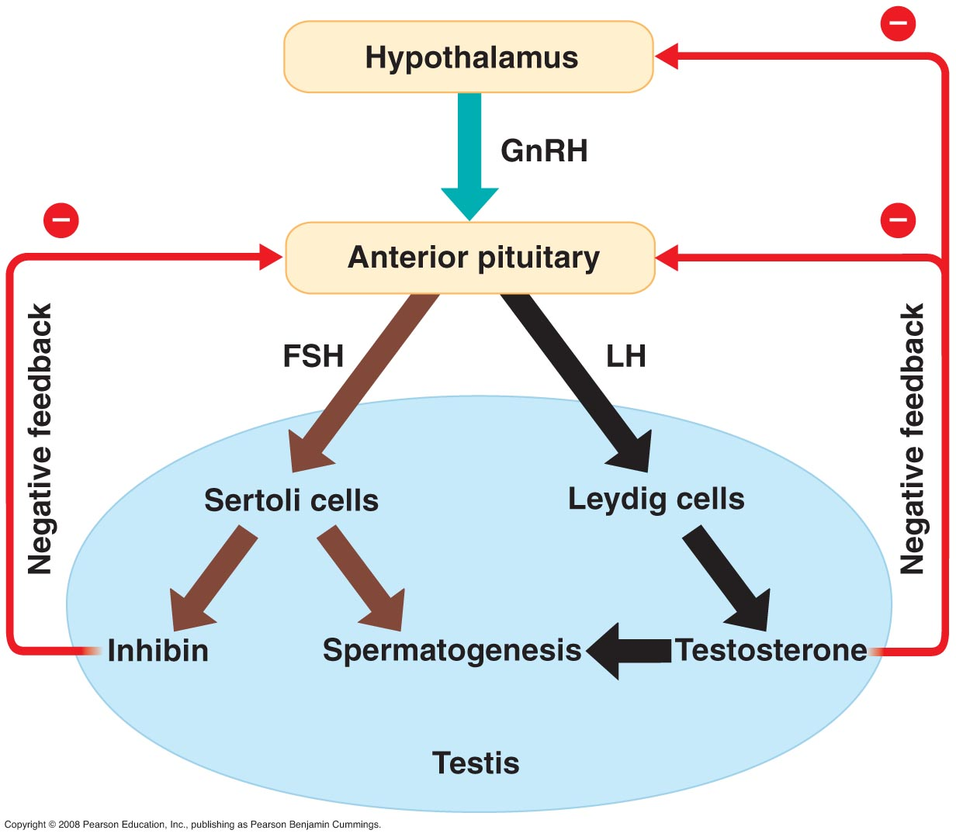
Hormones in the male reproductive system
GnRH → FSH & LH
FSH stimulates sertoli cells in the seminiferous tubules
LH stimulates leydig cells to secrete androgens
Inhibin and testosterone regulate levels of GnRH, FSH, and LH
Gonadotropin releasing hormone
Fig 46.13 Campbell & Reece
Notes:
Note fsh and lh play similar (though not identical) roles in regulation of male and female gamete production. FSH promotes activity of Sertolic cells, which are located in the seminiferous tubules and nourish developing sperm. LH regulates Leydig cells, which are located in spaces between the seminiferous tubules. Leydig cells secrete testosterone and other androgens in response to LH, which then promotes speratogenesis in the tubules.
Two negative feedback loops control sex hormone production in males. Testosterone regulates blood levesl of gnrh, fsh, and luh through inhibitory effects on the hypothalamus and anterior pituitary. In addition, a hormone called inhibin, is produced by Sertoli cells which acts on the anterior pituitary to reduce fsh secretion.

Slide 23
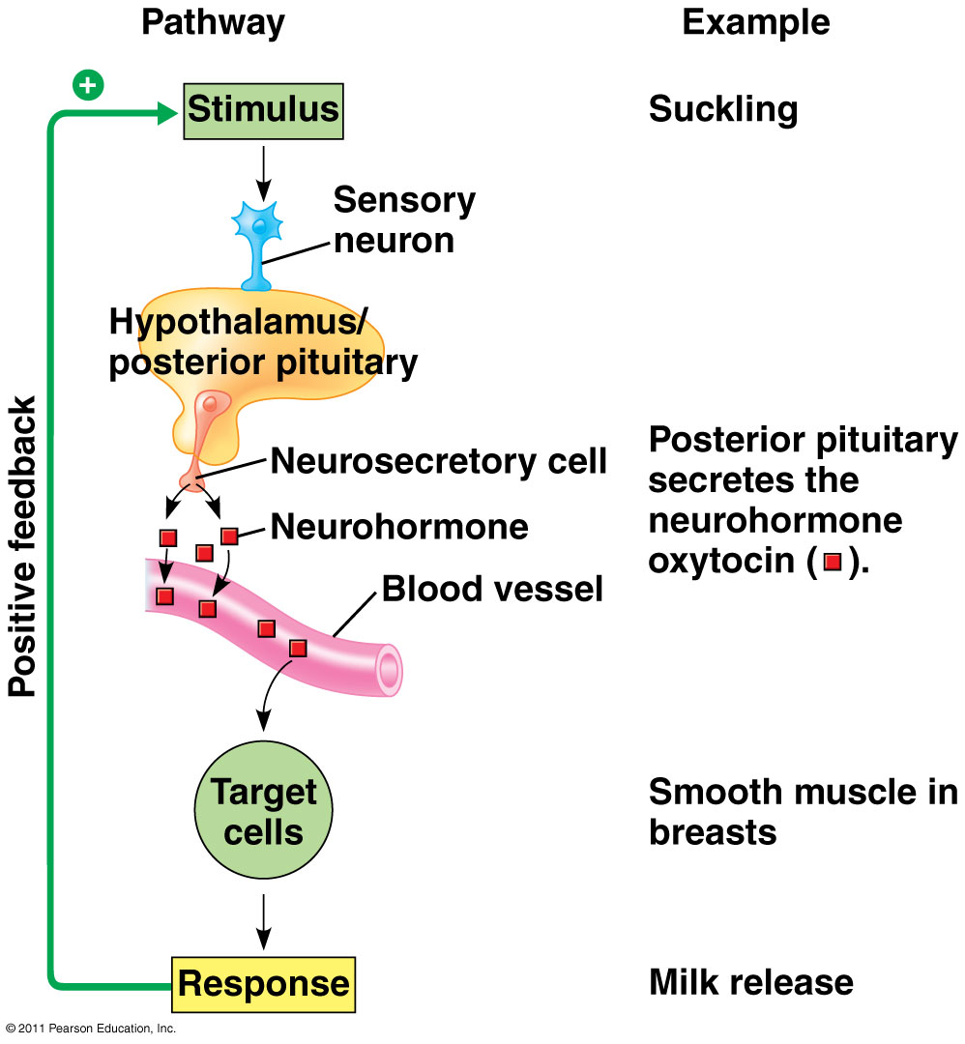
Oxytocin feedback loop
Stimulates uterine contractions during birth and milk ejection during nursing
Establishes maternal behavior
Campbell 8e 45.15
Notes:
Why is this positive and not negative feedback?
Uterine contractions and milk letdown – both positive feedback loops
Pitocin = synthetic oxytocin to induce labor

Slide 24
Oxytocin in males: the “love” hormone?
Produced in hypothalamus and testis
Released during ejaculation
Present in ejaculate: may facilitate sperm transport in both males and females?
Males treated with oxytocin rate their female partners as more attractive compared to other females
http://www.vivo.colostate.edu/hbooks/pathphys/endocrine/hypopit/oxytocin.html
http://healthland.time.com/2013/11/27/how-oxytocin-makes-men-almost-monogamous/

Slide 25
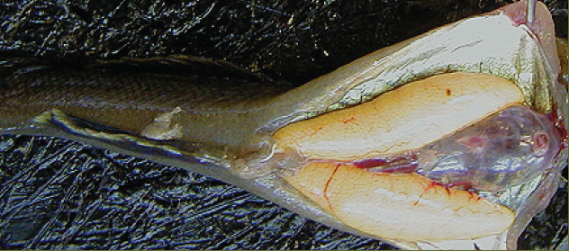
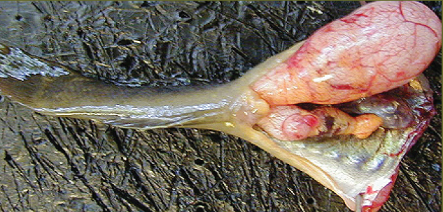
Endocrine disruptors in the environment
Medications, polychlorinated biphenyls, DDT and other pesticides, plasticizers including bisphenol A…
Interfere with hormonal regulation
In humans, endometriosis & cancers
In non-human vertebrates, male sterility, hermaphroditism, developmental abnormalities
Gonads of Longjaw mudsucker. Left: normal ovaries of equal size. Right: “ovotestes; the upper gonad is an enlarged testes with sperm, while the smaller lower gonad consists of some testicular tissue and ovary (orange color).
Pacific Estuarine Ecosystem Indicator Research Consortium
Notes:
http://www.niehs.nih.gov/health/topics/agents/endocrine/index.cfm
www.usgs.gov/themes/FS-189-97/

